Slide 1
Scala programming Part 2

Slide 2
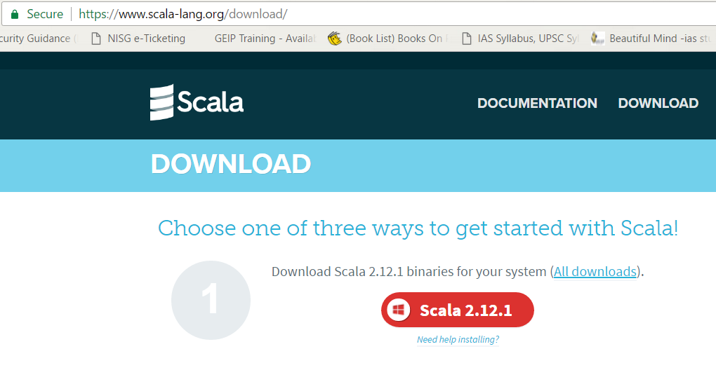
Programming environments: Scala REPL, Scala IDE for Eclipse
Download Scala binaries to install Scala and run Scala REPL
https://www.scala-lang.org/download/
Scala IDE for eclipse may be downloaded from:
http://scala-ide.org/download/current.html

Slide 3
Recap last session
Scala programming environments – Scala REPL and IDE
Mutable and Immutable variables
Block expressions
Lazy loading
foreach()
for loop
yield function
Notes:
Type-safe: Type checking is performed at compile time rather than on run-time

Slide 4
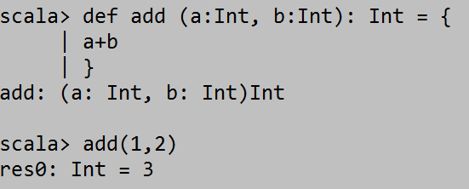
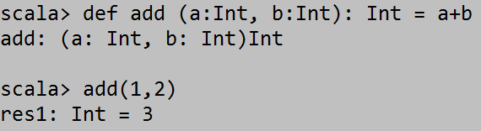
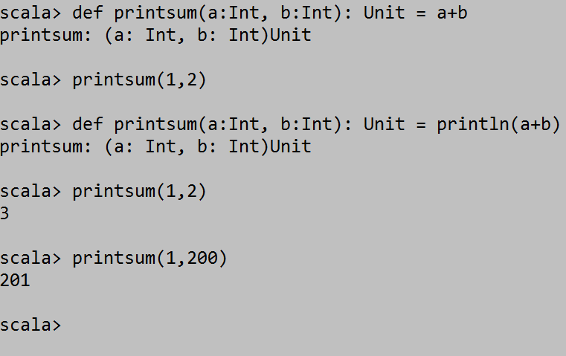
Declaring Functions in Scala
def function_name (function params): return_type = {
code
}
def function_name (function params): Unit = {
code
}
Notes:
Unit is like Void

Slide 5
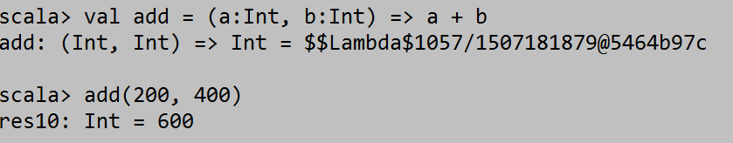
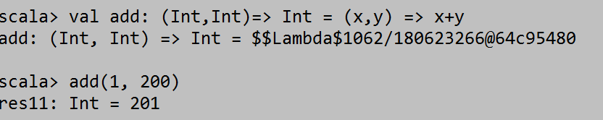
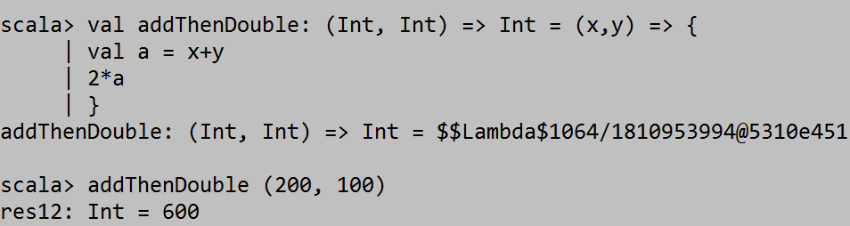
Define functions as variables
Implicit return type
Explicit declaration of return type

Slide 6
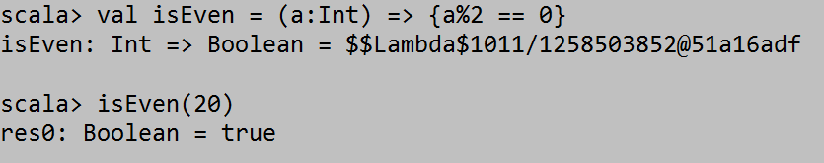
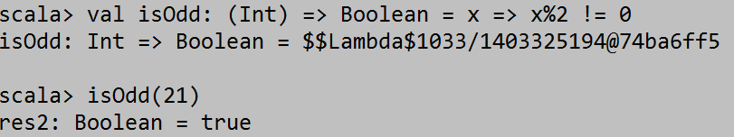
Define functions as variables contd..
Implicit return type
Explicit declaration of return type

Slide 7
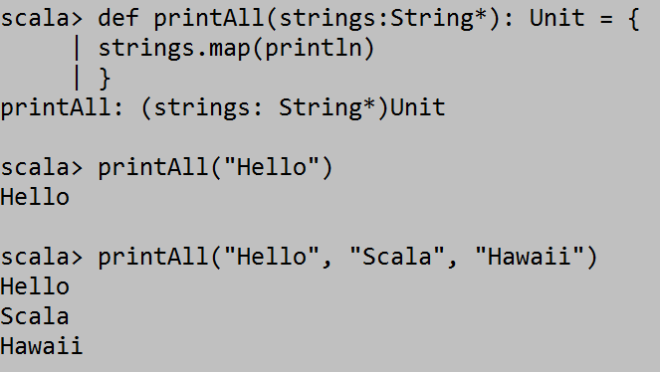
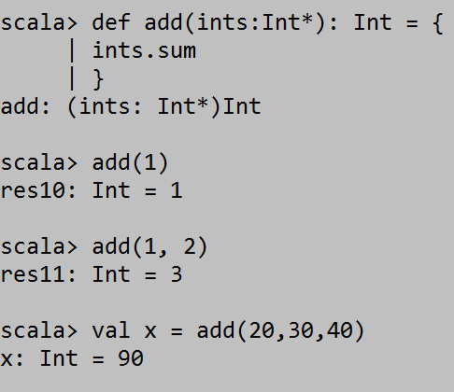
Functions with variable number of args

Slide 8
Collections in Scala
Arrays
ArrayBuffers
Maps
Tuples
Lists

Slide 9
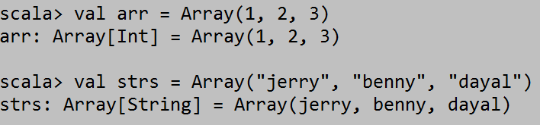
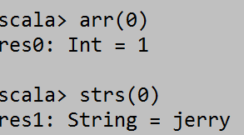
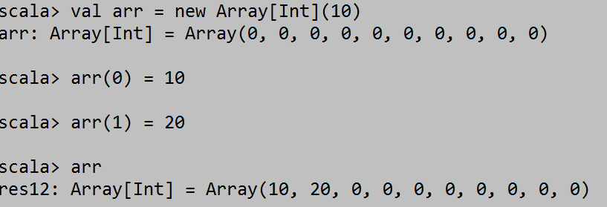
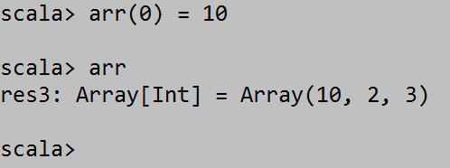
Collections: Array
Arrays are Fixed length
Mutable in terms of elements (elements can be changed)
Immutable in size (size can not be changed later)
Implicitly under Scala package, so no need to import
Declare statically or dynamically

Slide 10
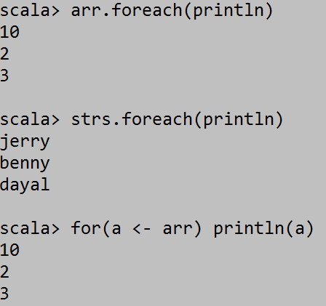

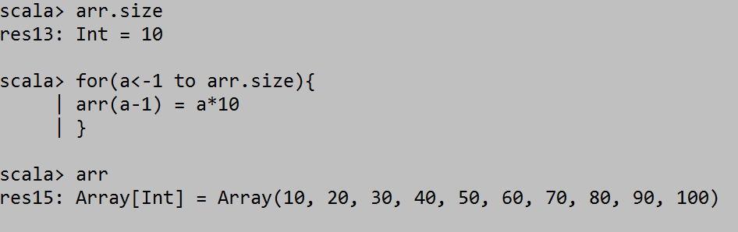
Collections: Array contd..
Array functions
arr.sum
Arr.min
Arr.max
arr.filter()
arr.reduce ()

Slide 11
Collections: More ways to create Arrays
Array.range (1,10)
Array.range (1,10,2)
Array.fill(5)(“Hello”)
Array.tabulate(5)(n => n*100)
“Hello”.toArray
(1 to 10).toArray
List(1,2,3,4).toArray

Slide 12
Collections: ArrayBuffer
ArrayBuffer is mutable in size
Not implicitly under Scala package, so need to import
import scala.collection.mutable.ArrayBuffer

